Slide 1
Earning Analysis Prediction challenge 3 HW-11
-Nitin Gowda

Slide 2
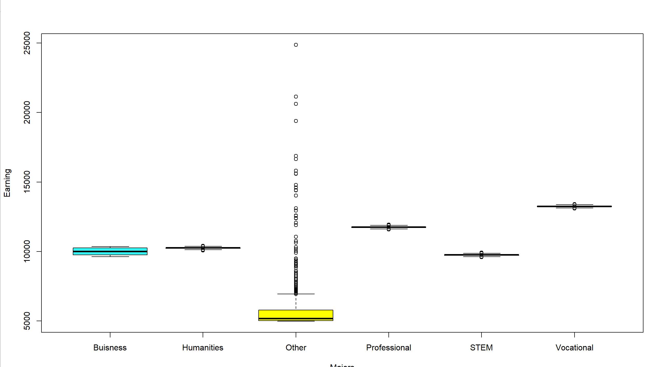
Relationship between major and earnings
From the box plot, all majors have a very small range except ‘other’ and do not tend to do much.
Therefore, leaving ‘other’, major is a good way to narrow someone’s income down.

Slide 3
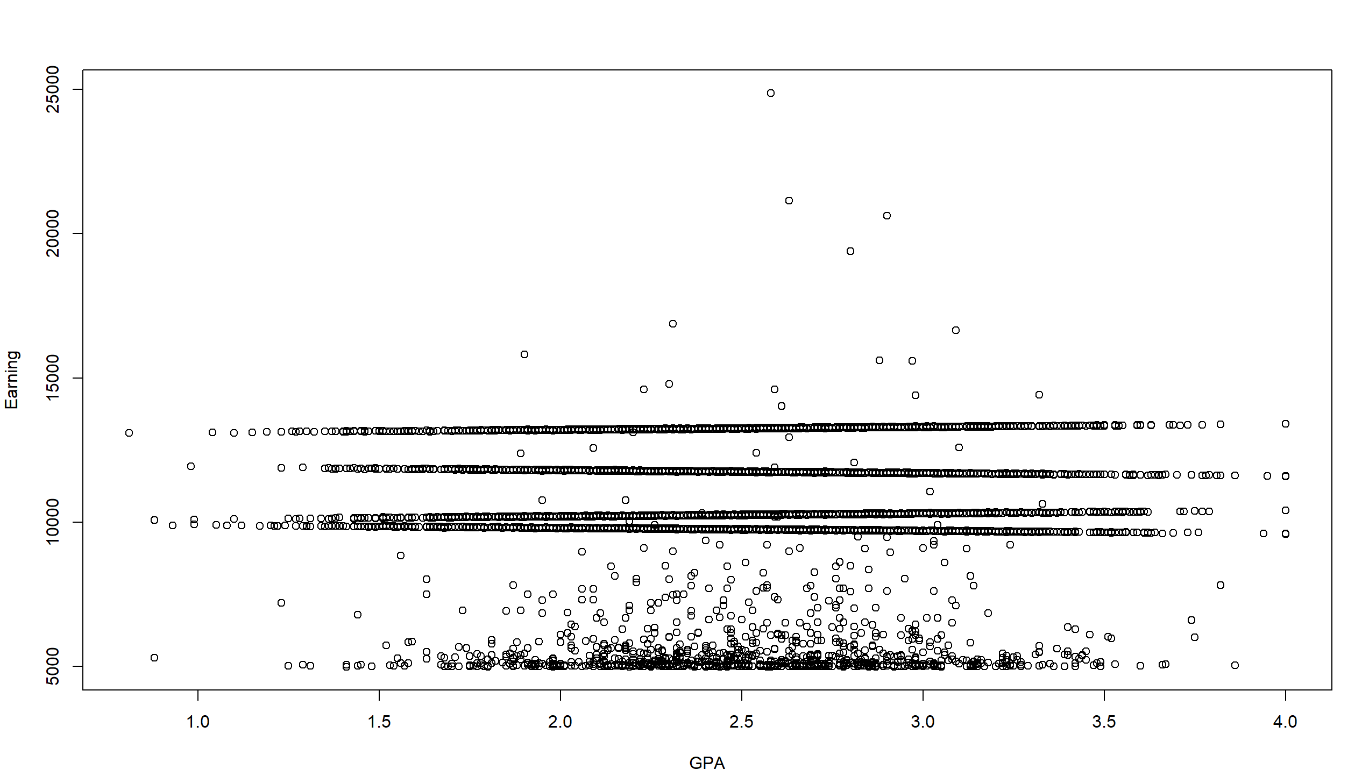
Relationship between GPA and earnings
As you can see in the scatter plot on the bottom, there are weird ‘trend lines’ formed with GPA.
This shows that GPA too affects earnings in a weird way.

Slide 4
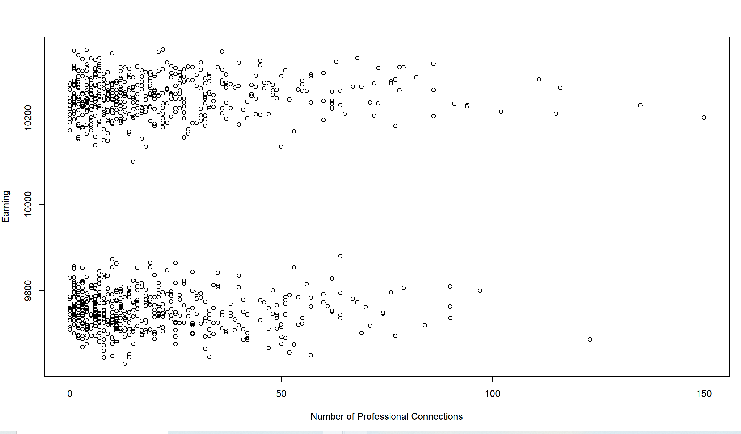
Relationship between number of professional connections and earnings
As you can see in the scatter plot on the bottom, there are different trends formed with professional connection.
Breaking this further down into certain majors (subsetting by major and plotting the same graph on the right) show that each trend line is associated with a different major.

Slide 5
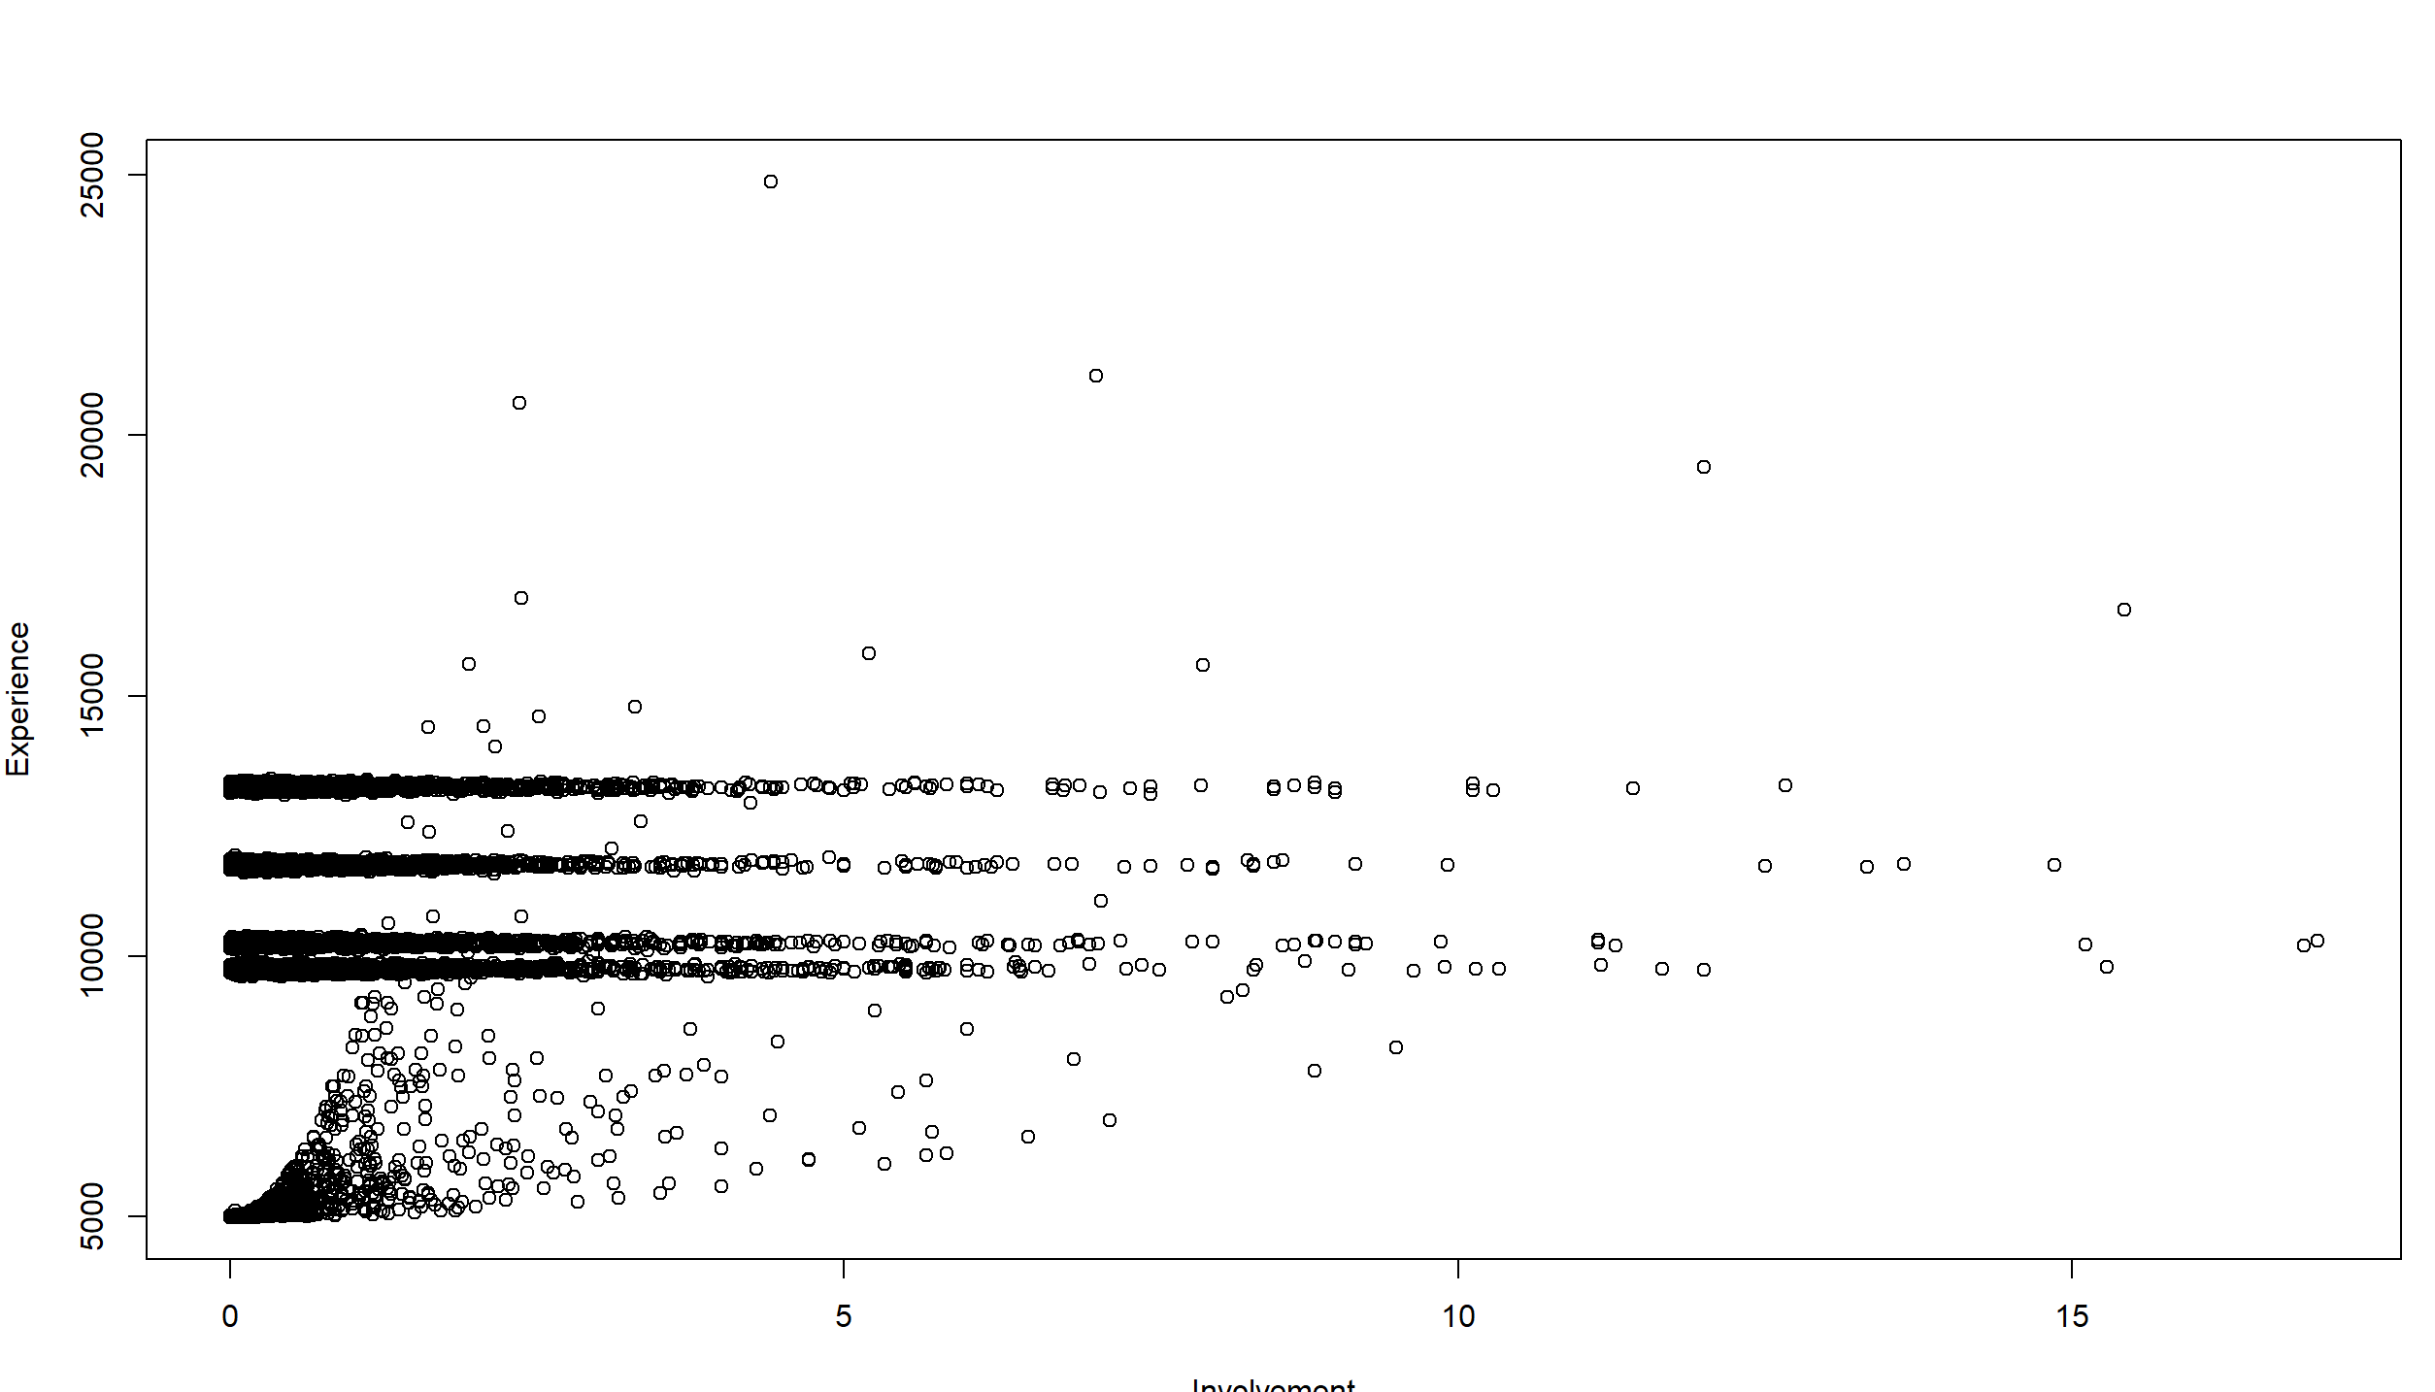
Addition of new columns - involvement
Year of graduation alone is useless since it doesn’t tell us much.
However, we can use that data to see how active the person is amongst the ‘working community’. To see how engaged the person is in the working community we can divide number of connections by number of years of experience.
Number of years of experience is 2021 - graduation year.
The graph on the right is similar to the previous graph as it also shows trend lines.

Slide 6
Addition of new columns – converting major in numeric values
Major is a categorical column. Machine learning models such as linear regression require numbers to find the best fit line. Hence, to convert it into numerical values we can manually encode it.
Code:
decision <- rep(0,nrow(earnings))
decision[earnings$Major == "Humanities"] <- 1
decision[earnings$Major == "Vocational"] <- 2
decision[earnings$Major == "Professional"] <- 3
decision[earnings$Major == "Buisness"] <- 4
decision[earnings$Major == "Other"] <- 5
earnings$MajorNum <- decision

Slide 7
Linear regression
Using the linear regression model let us pass in the parameters and the predicting column and see how it fares by calculating it’s error(mean squared error).
Code:
trainLm <- lm(Earnings ~ GPA + MajorNum + Number_Of_Parking_Tickets + Number_Of_Credits + Involvement, data = train)
predLm <- predict(trainLm, newdata = test)
error <- mean((predLm - test$Earnings)^2)

Slide 8
Decision tree
Using the decision tree model let us pass in the parameters and the predicting column and see how it fares by calculating it’s error(mean squared error).
Code:
tree <- rpart(Earnings ~ GPA + Number_Of_Professional_Connections + Major + Graduation_Year + Number_Of_Credits + Number_Of_Parking_Tickets, data = train, method = "anova")
rpart.plot(tree)
test$NewEarnings <- predict(tree, newdata = test)
error <- mean((test$NewEarnings - test$Earnings)^2)

Slide 9
Random forest
Using the random forest model let us pass in the parameters and the predicting column and see how it fares by calculating it’s error(mean squared error).
Code:
trainRf <- randomForest(Earnings ~ GPA + Number_Of_Professional_Connections + Major + Graduation_Year + Number_Of_Credits + Number_Of_Parking_Tickets, data = train)
predRf <- predict(trainRf, newdata = test) error <- mean((predRf - test$Earnings)^2)

Slide 10
SVM
Using the svm model let us pass in the parameters and the predicting column and see how it fares by calculating it’s error(mean squared error).
Code:
trainSvm = svm(Earnings ~ GPA + Number_Of_Professional_Connections + Major + Number_Of_Parking_Tickets + Number_Of_Credits + Graduation_Year, data = train)
predSvm <- predict(trainSvm, newdata = test) error <- mean((predSvm - test$Earnings)^2)
The mean square error or ‘error’ averages around 50,000. It was always a bit higher than our decision tree model. Taking the square root of MSE we get 224. Hence, our prediction’s mean is off by 224 dollars(Earnings). This is the best model and therefore this is the best result.

Slide 11
Thank you!

